Slide 1

A look at
by Nicholas Pelliccia

Slide 2
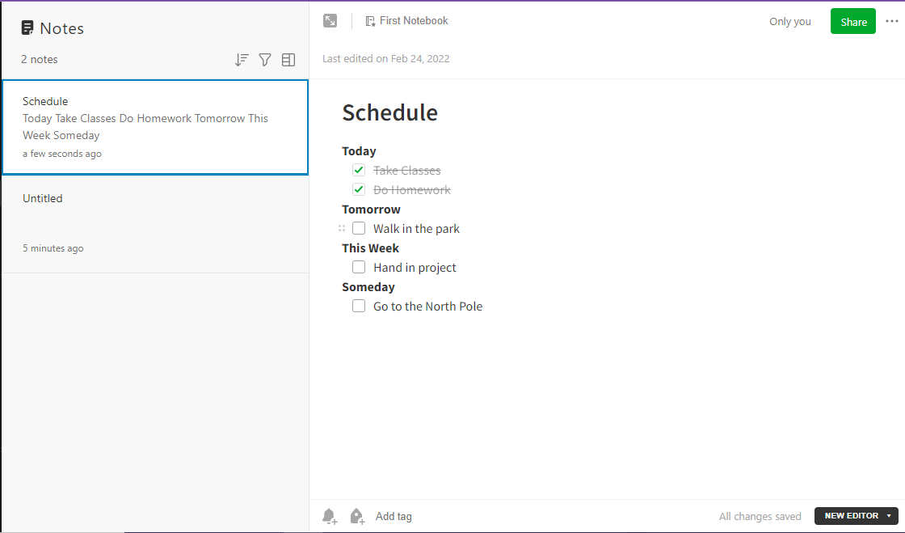
What is Evernote?
An application used for note-taking, task management, and organizing
Available on Android, iOS, Windows, MacOS, and Linux
Allows you to sync notes between your devices
Integrated with Google Drive, Outlook, MS Teams, and Gmail
A web application – can be used from web browsers

Slide 3



History
Founded in 2000 by Stepan Pachikov and Phil Libin
Based in Redwood City, CA
Started as a note-taking and web-clipping application for Windows
Shifted focus towards the web and smartphones with version 3.0 in 2008
Has seen a decline in popularity as new competitors became popular
Redesigned to include Tasks, Home, and new paid plans in 2021.
Current CEO is Ian Small
Stepan Pachikov
Phil Libin
Ian Small

Slide 4
Membership Plans
Free
Sync up to 2 devices
60 MB monthly uploads
25 MB max. note size
Clip web pages
Attach files
Good for just taking notes
$0.00/mo
Personal
Sync unlimited devices
10 GB monthly uploads
200 MB max. note size
Ability to manage tasks
Connect Google Calendar
Offline access to notes
Search inside images and PDFs
Mark up images and PDFs
$7.99/mo
Professional
Everything in Personal plan
20 GB monthly uploads
Create and assign tasks to others
Use Boolean terms to refine searches
Find content by location
Export notebooks as PDFs
$9.99/mo

Slide 5
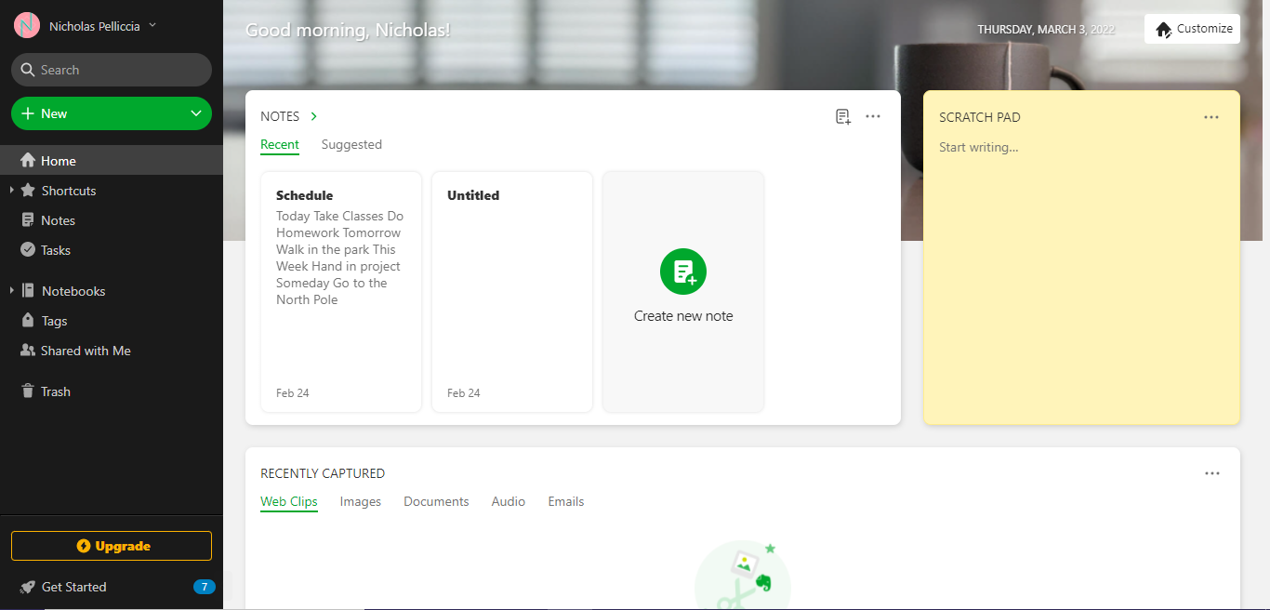
Number of visitors and Rank
Evernote had 33.1 million visitors in Dec. 2021.
23% of visitors were from the United States, 21% were from Japan
Evernote is ranked #1,489 out of all websites
Evernote has over 250 million users overall.

Slide 6
Future
Evernote wants to achieve Pachikov’s goal of being “an extension of the human brain.”
Evernote plans on making recently added features better over time.
Competitors like Microsoft OneNote and Google Keep could keep taking market share from Evernote.
People might not like the new features and paid plans that Evernote has rolled out

